Slide 1

Development of a Dynamic, Data-Driven Reporting Module for NPCYF
Submitted by: SHRITANU MONDAL –M.A IN ECONOMICS(ENERGY ECONOMICS)
DEPARTMENT OF ECONOMICS BANARAS HINDU UNIVERSITY ,VARANASI-221005
Report submitted to: IDEAS – Institute of Data Engineering, Analytics and Science Foundation, ISI Kolkata
Mentor: Mr. Samyabrata Roy
Programme: Autumn Internship – Data Science (2025)

Slide 2
ACKNOWLEDGEMENT
I wish to express my deepest gratitude to all the individuals and organizations who contributed to the successful completion of this project, "Dynamic Reporting Module for Crop Yield Forecasts," undertaken as part of the Autumn Internship Program on Data Science 2025. A special note of appreciation goes to my mentor, Mr. Samyabrata Roy (IDEAS-TIH/ISI Kolkata), for his exceptional guidance . I also extend my sincere thanks to the leadership and management team at the Institute of Data Engineering, Analytics and Science Foundation (IDEAS-TIH), Indian Statistical Institute (ISI) Kolkata, including:
Dr. Sanghamitra Bandyopadhyay, Director, IDEAS-TIH
Dr. Agnimitra Biswas, Chief Executive Officer (CEO)
Ms. Bidisha Dobe, Operations & Training Manager
Mr. Diptendu Dutta, Technology Lead
Regards,
SHRITANU MONDAL

Slide 3
Contents:
1.Intriduction……………………………………………………………………………….4
2. Purpose of the Project…………………………………………………………………...5
3. Objectives………………………………………………………………………………...6
4. What the Project Illustrates…………………………………………………………….7
5. Tools & Technologies Used……………………………………………………………...8
6. Methodology……………………………………………………………………………..9
7. Dynamic Report Generation…………………………………………………………..10
8. Results and conclusion………………………………………………………………....11
9.Thank You…………………………………………………………………………….....12

Slide 4
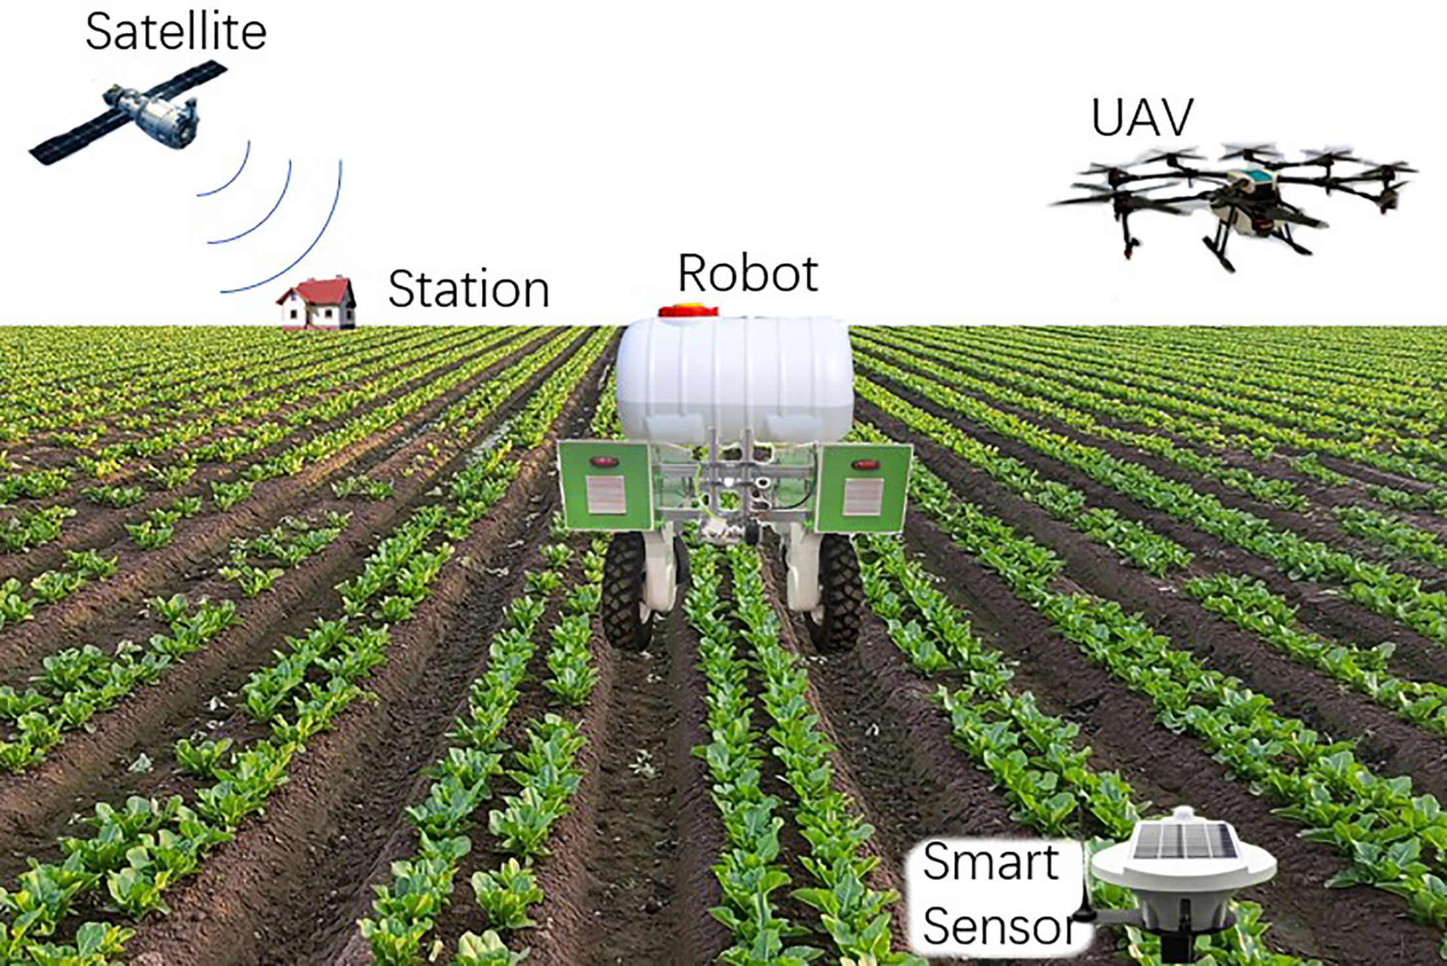
Introduction
• NPCYF is India’s national program for crop yield forecasting
• Powered by remote sensing, weather & ground-based observations
• Requires standardized, automated reporting
This Photo by Unknown Author is licensed under CC BY

Slide 5
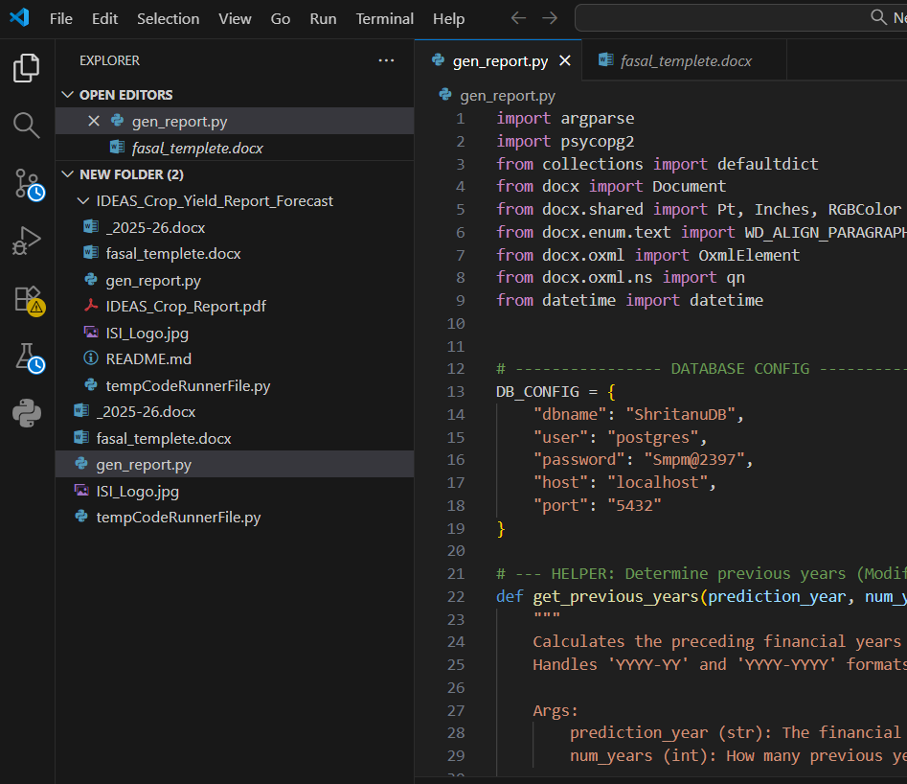
Purpose of the Project
• Automate official MoA&FW crop-forecast reports
• Fetch data dynamically from PostgreSQL
• Reduce manual intervention and human error
• Ensure real-time readiness for policy workflows

Slide 6
Objectives
Design
Design a dynamic reporting engine for NPCYF
Ensure
Ensure accurate real-time data retrieval from PostgreSQL
Implement
Implement automated column generation based on DB content
Generate
Generate clean, professional DOCX reports for policymakers
Build
Build a modular backend ready for NPCYF platform integration

Slide 7
What the Project Illustrates
• Real-time data utilization
• Scalable backend architecture
• End-to-end data pipeline: DB → Python → DOCX
• Automation of machine-learning outputs
• Government-grade document generation

Slide 8

Tools & Technologies Used
• Python – core development
• PostgreSQL – data storage
• psycopg2 – DB connection
• python-docx – DOCX generation
• GitHub – version control
This Photo by Unknown Author is licensed under CC BY

Slide 9
Methodology
Database setup
Static report generation
Dynamic column fetching
Automated DOCX formatting
Final output verification

Slide 10
Dynamic Report Generation
• Automatically detects available methods (RF, ARIMA, XGBoost)
• Automatically detects MoA&FW years
• Builds headers accordingly
• No manual code updates needed

Slide 11

Results and conclusion
Report Table Example: State | RF Forecast | 2024-25 MoA&FW | 2023-24 MoA&FW
• Fully automated DOCX generation
• Dynamic headers verified
• Accurate data population
• Compliance with NPCYF/MoA&FW format

Slide 12
Thank You

